Slide 1
Oracle Transforms Construction Safety Management with AI
Week 2
Ed Elowson

Slide 2
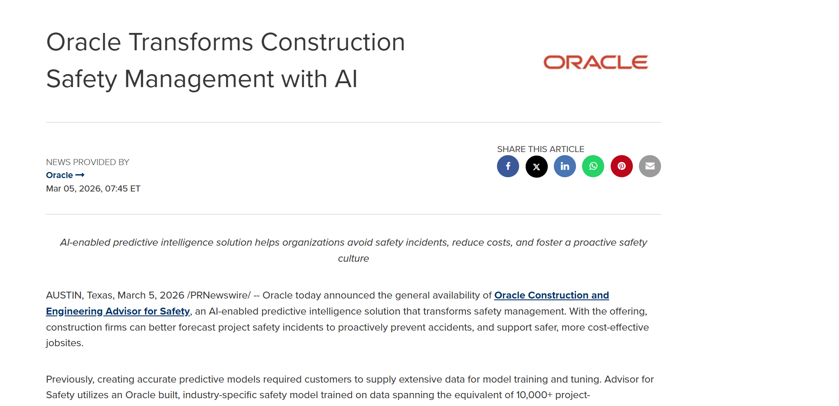
Screenshot

Slide 3
Link to the Source
https://www.prnewswire.com/news-releases/oracle-transforms-construction-safety-management-with-ai-302704313.html

Slide 4
Main Findings
Main Findings
Oracle announced the general availability of Oracle Construction and Engineering Advisor for Safety, an AI-powered predictive intelligence tool designed to improve safety management in construction projects.
Key findings and features include:
Predictive AI safety modeling: The system uses an industry-specific AI model trained on 10,000+ project-years of construction data, allowing firms to predict safety risks even if they lack extensive internal safety datasets.
Weekly risk forecasting: The platform identifies the top 20% of projects likely to generate 80% of safety incidents, enabling targeted resource allocation.
Observation-based safety data collection: A new observation capability integrated into Oracle Aconex and Oracle Primavera Unifier lets field personnel record standardized safety observations via mobile or web tools.
Integrated data analytics: The system aggregates information from multiple sources including safety observations, incident reports, payroll, project schedules, and ERP systems such as Oracle Fusion Cloud ERP.
Demonstrated performance improvements: Early customer results show potential reductions of:
Up to 50% in safety incidents
Up to 75% in workers’ compensation costs within the first year
Overall, the platform shifts construction safety management from reactive (after incidents occur) to predictive (preventing incidents before they happen).

Slide 5
Broader Implications for Society
The development reflects several broader trends in the use of AI across industries:
Safer workplaces
Construction is historically one of the most hazardous industries, so predictive safety tools could significantly reduce injuries and fatalities.
Economic efficiency
Reducing accidents lowers:
insurance and compensation costs
project delays
legal liabilities
This can lead to more cost-efficient infrastructure development and potentially lower project costs for society.
Data-driven labor protection
AI systems that analyze workplace risks could contribute to more proactive occupational safety standards across industries.
Cultural shift in safety management
By emphasizing observation reporting and predictive insights, organizations may shift toward continuous risk monitoring rather than compliance-based safety programs.

Slide 6
Relevance and Potential Influence on the Construction Industry
The solution could meaningfully reshape construction management practices in several ways:
1. Transition to predictive safety management
Most construction safety systems rely on lagging indicators (incident reports). AI tools introduce leading indicators, enabling companies to anticipate and mitigate risks earlier.
2. Increased digitalization of job sites
The platform requires structured digital safety observations via mobile devices, accelerating the digitization of field operations.
3. Data integration across project systems
By combining data from scheduling, HR, and safety platforms, the system supports holistic project risk management rather than isolated safety tracking.
4. Competitive differentiation
Contractors adopting AI-driven safety tools may gain advantages through:
lower incident rates
reduced insurance costs
improved regulatory compliance
stronger safety reputations when bidding for projects.
5. Industry-wide benchmarking
Because the AI model is trained on large cross-project datasets, it may enable industry benchmarking and best-practice sharing, raising overall safety standards.

